Slide 1
INRIX Python ML workshop
WiFi: InrixEvent
PW: Welcome01

Slide 2
Agenda
6.30 – 6.45: introduction, machine learning overview
6.45 – 7.30: interactive notebook workthrough
7.30 – 8.00: break for pizza and drinks
8.00 – 9.00: interactive notebook workthrough

Slide 3
Machine learning at INRIX

Slide 4
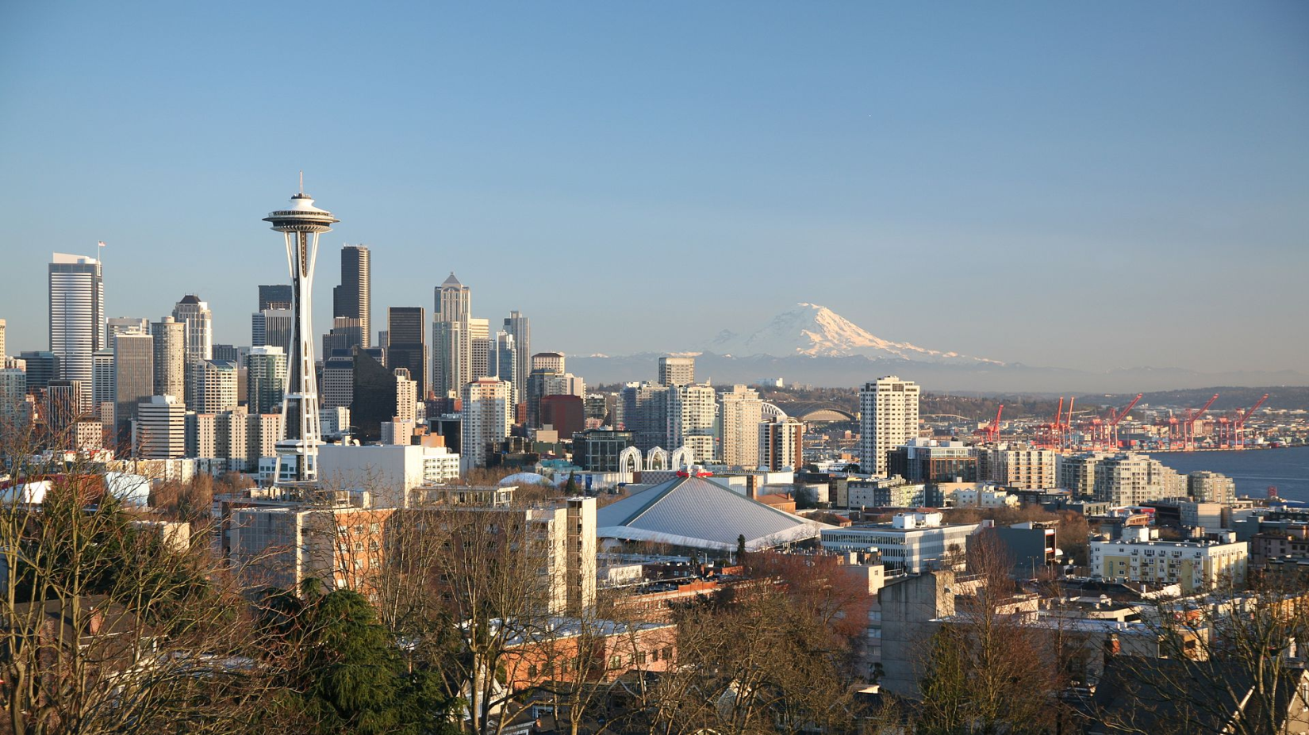
About INRIX
Based in Seattle, EU HQ in Manchester
Founded in 2005, spun out of Microsoft IP
Investment from Intel, Porsche IG, venture capital
Our mission is “to connect vehicles to cities and cities to vehicles”

Slide 5
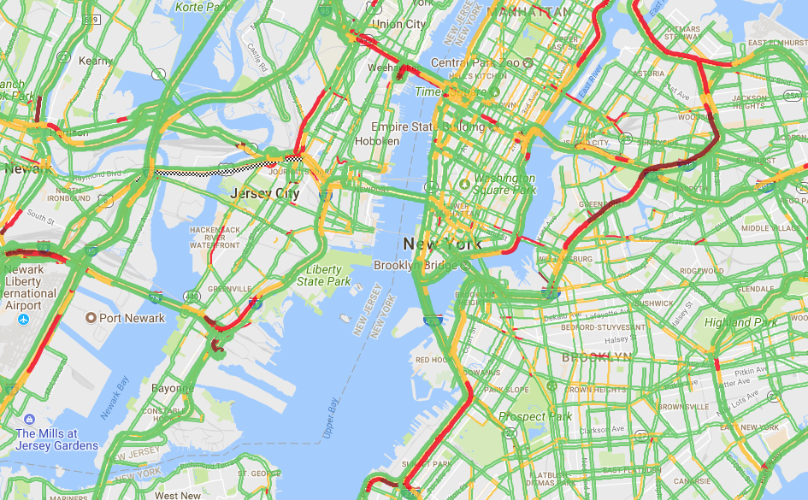
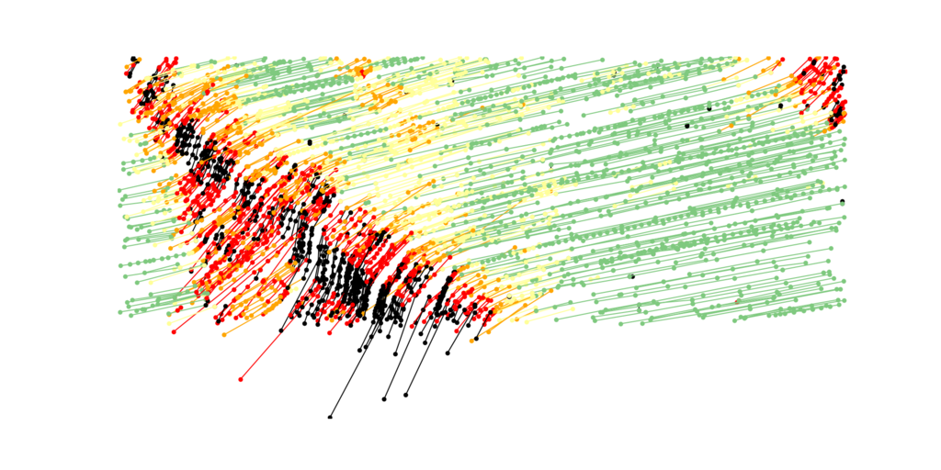
Machine learning at INRIX
What is the most likely speed on this road 10 minutes from now?
What is the probability of being able to park on this block on Saturday morning?
Can we accurately warn drivers they’re approaching a dangerous slowdown/back of a queue?
Has this GPS trace stopped at a gas station or stopped at a traffic light?
We collect billions of GPS points every day, from more than 300 million sources
We use a variety of machine learning techniques including neural networks (including convolutional neural networks for image recognition), XGBoost and random forests to address a range of problems.

Slide 6
Machine learning overview

Slide 7
Terminology overview – supervised learning - classification
Q: Given some information about a thing, which of a fixed number of classes does it belong to?
Features
e.g. x = (0, 1, -4, 5.2, …)
Model
Has parameters/weights that transform input features to predictions
Predictions
e.g. class B or probabilities over all classes
Labels
e.g. class A
Training
Change model parameters based on errors made using Loss function
e.g. categorical cross entropy
Input
Output

Slide 8
Terminology overview – supervised learning - regression
Q: Given some information about a thing, what is the value of some unknown quantity related to it?
Features
e.g. x = (0, 1, -4, 5.2, …)
Model
Has parameters/weights that transform input features to predictions
Predictions
e.g. 34.0
Labels
e.g. 56.0
Training
Change model parameters based on errors made using Loss function
e.g. mean squared error
Input
Output

Slide 9
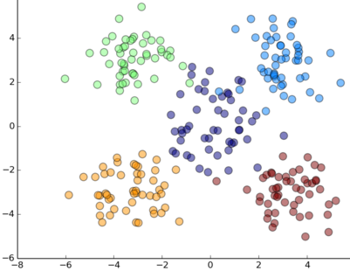
Terminology overview – unsupervised learning
Q: Given some information about a thing, how can we simplify this into groups/find similar examples?
e.g. K-means clustering
Features
e.g. x = (0, 1, -4, 5.2, …)
No Labels
Input

Slide 10
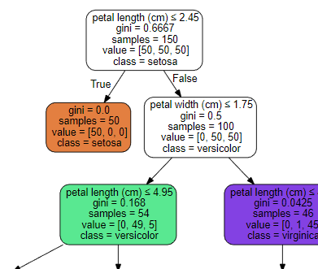
Decision tree models
Decision trees can be used for regression or classification problems (but we’ll focus on classification)
They work by generating a flowchart, where each node is a binary decision about a feature, and the end nodes (leaves) give you your classification.
They are one of the oldest and most straightforward machine learning techniques, but can still achieve good results.
Data science wisdom: avoid using a complicated model where a simpler one would work just as well!
Excerpt of iris dataset decision tree

Slide 11
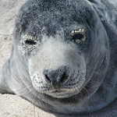

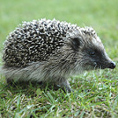



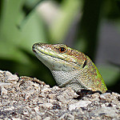
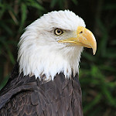
Example
Mammal
Seal
Bat
Hedgehog
Dog
We have 8 animals (training data rows), and we know certain things about these animals (our features). We know…
How many legs they have
Whether they fly or not
Whether they have fur or not
If they’re a mammal
Can we use the first three properties to build a decision tree to correctly classify all animals as either mammal/not mammal?
Octopus
Tarantula
Lizard
Eagle
Not mammal

Slide 12
Example
This tree has a depth of 3, as there are three tiers of questions (grey boxes).
It does a reasonable job of delineating the data into mammal/not mammal.
What if we restrict the depth to 2? What is the best we can do?
Can fly?
Y
N
Has fur?
Has fur?
Y
N
Y
N
Bat
Eagle
>4 legs?
If a new animal ends up at this leaf, it is a mammal with probability = 1
Y
Lizard
N
Octopus
Tarantula
Hedgehog
Seal
If a new animal ends up at this leaf, it is a mammal with probability = 0.33
Dog

Slide 13
Example
This tree has a depth of 3, as there are three tiers of questions (grey boxes).
It does a reasonable job of delineating the data into mammal/not mammal.
What if we restrict the depth to 2? What is the best we can do?
<=4 legs
Y
N
Has fur?
Tarantula
Y
N
Octopus
Bat
Eagle
Seal
Lizard
Dog
Hedgehog
If a new animal ends up at this leaf, it is a mammal with probability = 0.33

Slide 14
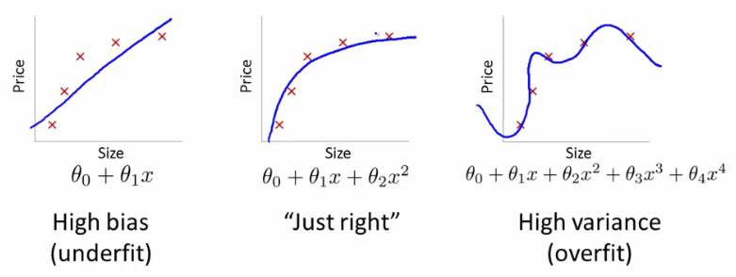
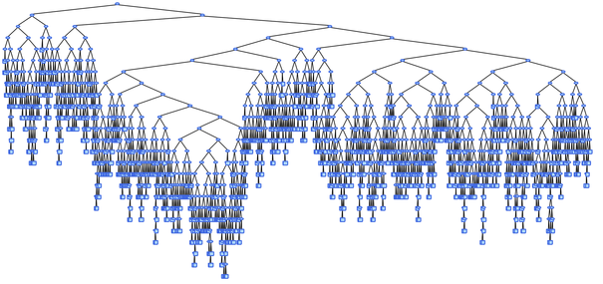
Bias and variance in decision trees
Bias: how well the model has understood the relationship between the training data and the target variable (high = bad)
Variance: how much the model output depends on the specific training data that was used (high = bad)
Bias and variance work as a trade-off. Less of one generally means more of the other.
Decision trees tend to be low-bias and high-variance, as they can grow deep in a way that describes the training data perfectly (low bias), but would classify new data poorly (high variance).

Slide 15
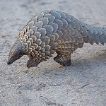
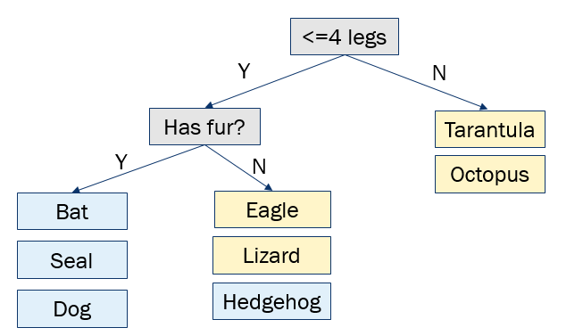
Testing a decision tree model
To test our tree, we run new data (with known labels) through the tree. By answering the questions, we will end up at a leaf node for each new piece of data. Does the true label match the predicted label at this leaf?
If we find that the tree makes lots of mistakes, this could mean that the model is…
Overfitting: the decision tree matches the training data too closely and is unable to generalise to new data it hasn’t seen before (high variance)
Underfitting: the decision tree hasn’t managed to capture the relationships in the data well enough (high bias)
In decision trees, overfitting tends to be more common. One way we can mitigate against this is by putting restrictions on how the tree is generated.
Pangolin

Slide 16
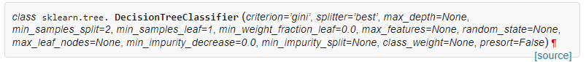
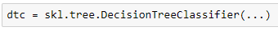
Decision tree parameters
There are many aspects of the decision tree model that we can control/fix, e.g. …
min_samples_split, min_samples_leaf
Only turn a leaf into a new decision mode if at least n rows in the training data end up at this leaf. To prevent overfitting.
criterion = ‘gini’ or ‘entropy’
Both are metrics of how effectively a decision tree model categorises the data, by looking at the impurity or entropy of the samples at the leaves.

Slide 17
The dataset

Slide 18
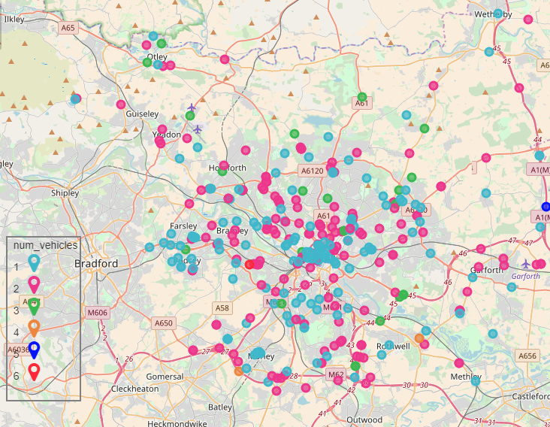
Road traffic accidents – Leeds City Council
The dataset describes all road traffic accident casualties across Leeds between 2009 and 2015
It includes many features, such as the type of road, the weather and lighting conditions at the time of the accident, and what type of vehicle was involved.
One field is the severity of the incident (either ‘Slight’ or ‘Serious’), and this is what we’re trying to predict
Right: serious traffic accidents in 2015 by number of vehicles involved

Slide 19
Let’s go!

Slide 20
Part 1 – loading and cleaning the data

Slide 21
Part 1 – loading and cleaning the data
Machine learning is smart, but not smart enough to handle junk input data.
The first step of any problem is to get to know the data you’re working with and ask the right questions, in this case: do I need to fix or even throw out any of the data?
Domain knowledge is often valuable here.
Possible issues
Incomplete
Duplicated
Inconsistent
Typos
Duplicated

Slide 22
Part 2 – exploratory analysis and feature engineering

Slide 23
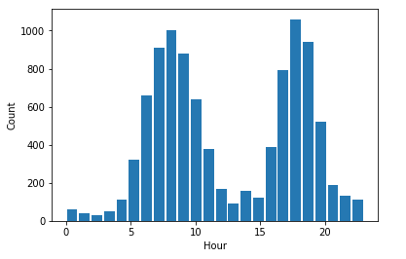
Part 2 – EDA & feature engineering
The goal here is to do some initial analysis of our dataset to get a feel for the distributions and relationships that are in there, and then use this information to ensure we get the most out of the data when it comes to training a model for making predictions.
Good questions to ask:
Are there any significant imbalances in the data?
Can we turn existing features into more useful features?
Do we need to normalize the data in any way?
Are there some aspects of the data that definitely won’t be useful?
Example: we have a dataset including a timestamp column. We extract the hour and plot the distribution of hour values. It might be more useful to decompose this into ‘am’ and ‘pm’ values to replace the timestamp field.
Feature engineering can be more of an art than a science, and it often happens iteratively.

Slide 24
Part 2 – EDA & feature engineering – one-hot encoding
Many ML algorithms will not work with categorical data like below left
Some categorical data is ordinal – be careful!
One method for transforming this is one-hot encoding
This works well for decision trees designed to make binary decisions
Restaurant | Cuisine
Pizza Express | Italian
Wagamama | Japanese
Frankie & Benny’s | American
Yo Sushi | Japanese
Bella Italia | Italian
Restaurant | is_Italian | is_Japanese | is_American
Pizza Express | 1 | 0 | 0
Wagamama | 0 | 1 | 0
Frankie & Benny’s | 0 | 0 | 1
Yo Sushi | 0 | 1 | 0
Bella Italia | 1 | 0 | 0

Slide 25
Part 3 – training the model

Slide 26
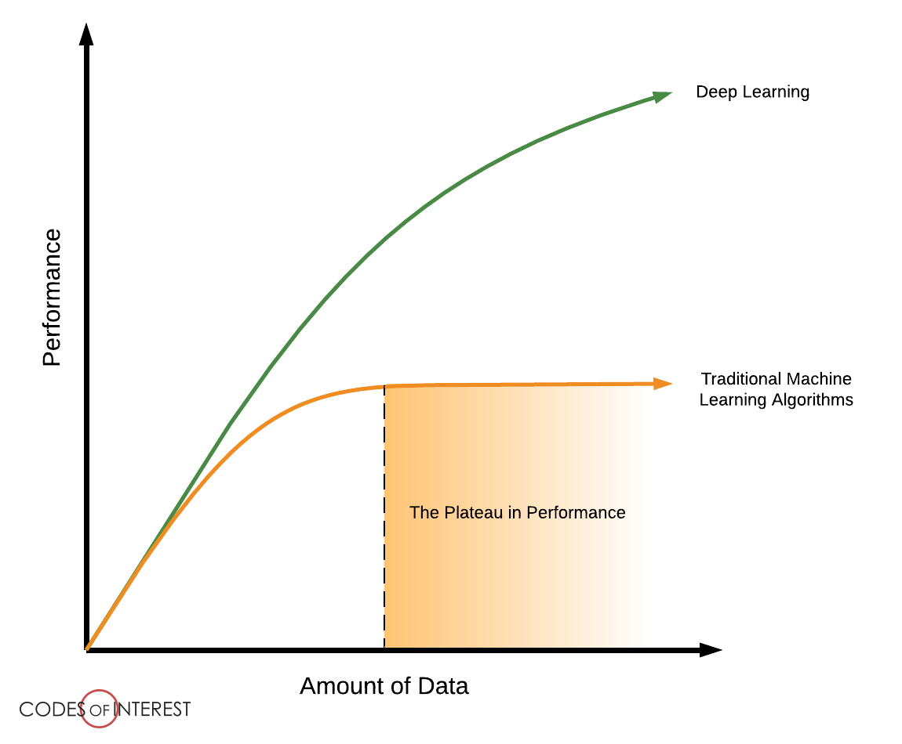
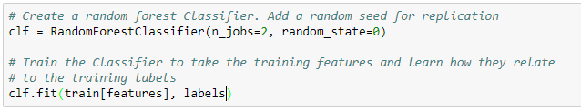
Part 3 – training the model
“AI is akin to building a rocket ship. You need a huge engine and a lot of fuel. The rocket engine is the learning algorithms but the fuel is the huge amounts of data we can feed to these algorithms.” –Andrew Ng
A supervised ML algorithm identifies patterns in the labelled training data and from these patterns attempts to learn relationships between the data and its label in order to make future predictions
Generally, the more training data we have, the better our model’s predictions.
Training a ML model with Python’s ML library, scikit-learn is very
straightforward. First one needs to initialise the ML algorithm to be used
and then is fitted to the training features and their respective labels.

Slide 27
Part 3 – training the model - data structure
Once we have the features we want and have the data in a usable format, we need to use it to train a model.
This means separating out the features we want it to train on (feature matrix X) from the true labels (target vector y) we want it to use to optimize the model.
Each row in matrix X corresponds to a row of data, and the corresponding entry in vector y is the true label for that sample.
Name | Num legs | Fur | Fly | Mammal
Bat | 2 | 1 | 1 | 1
Dog | 4 | 1 | 0 | 1
Eagle | 2 | 0 | 1 | 0
Hedgehog | 4 | 0 | 0 | 1
Lizard | 4 | 0 | 0 | 0
Octopus | 8 | 0 | 0 | 0
Seal | 0 | 1 | 0 | 1
Tarantula | 8 | 0 | 0 | 0
Feature matrix X
Target vector y

Slide 28
Part 3 – training the model – splitting data into training vs test
But we don’t use all this data to train the model. We need to keep some aside so that after we’ve trained the model, we can show it some new unseen data (which we have true labels for) to see how well it does at classifying it. This will give us an idea of how well the model will perform in the future with completely new data.
We cannot use the data we used for training as the model can always remember the whole training dataset and therefore always predict the correct label → will not indicate whether our model will generalise well (perform well on new data).
Scikit-learn contains a function (train_test_split) that shuffles the data and splits it for you.
Input data
Size of test dataset
Output split data and labels
Input labels
Random seed
for replication

Slide 29
Part 4 – visualising the model

Slide 30
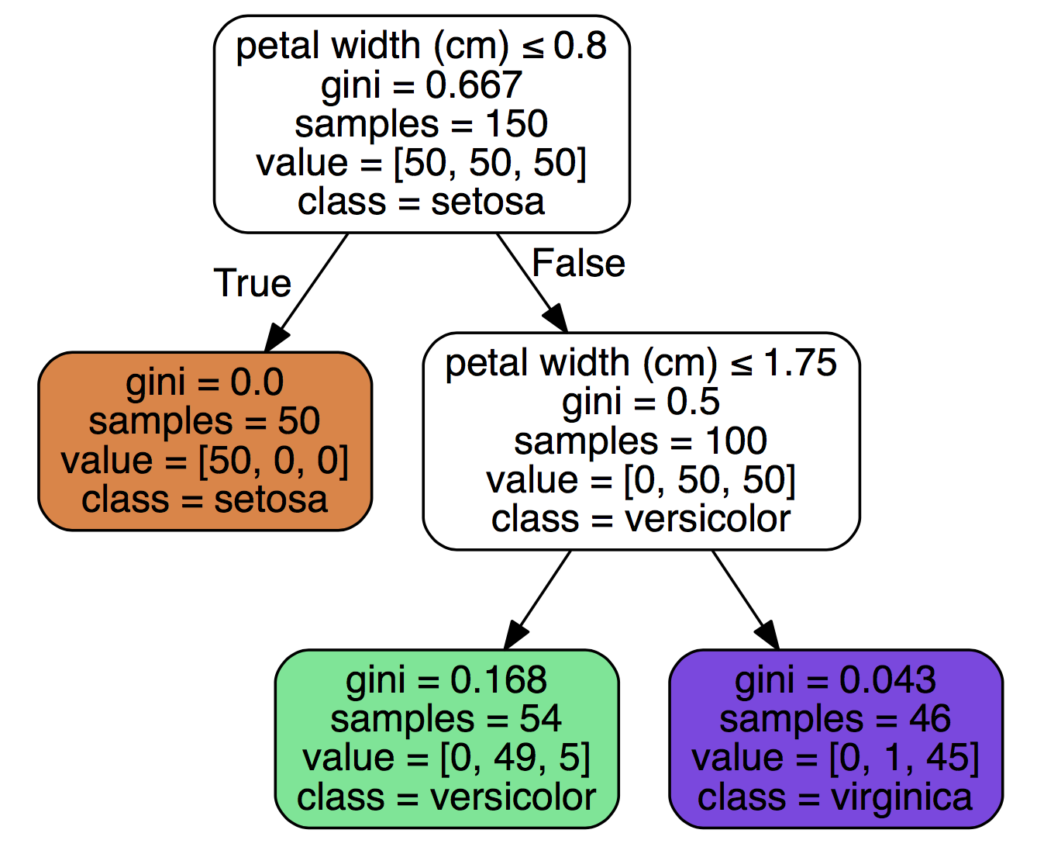
Part 4 – visualising the model
Decision trees lend themselves very well to visualization!
Scikit-learn decision tree models can be visualized using the Python library GraphViz.
Right: a simple decision tree model of a subset of the popular ‘iris’ dataset. We have a sample of flowers and want to classify them by petal width.
Here there are three possible types of flower (target classes): setosa, versicolor, and virginica
https://amunategui.github.io/simple-heuristics/index.html

Slide 31
Part 5 – evaluating the model

Slide 32
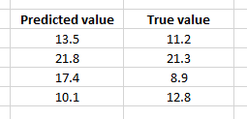
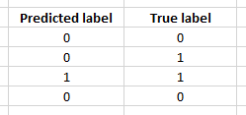
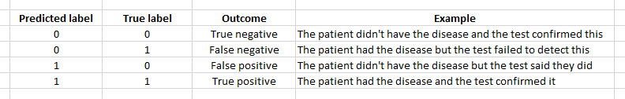
Part 5 – evaluating the model
So now we have a bunch of predictions and a bunch of true values, we need to compare these to see how well our model is performing
Regression: we can use statistical methods like the mean squared error to assess performance
Classification: we move from a numerical comparison to a system of ‘hits and misses’

Slide 33

Part 5 – evaluating the model – the confusion matrix
True Positives
205
True Positives
Everything along the main diagonal of the matrix is good.
False Negatives
51
Truly parking
Precision or Positive Predictive Value:
TP / (TP + FP) = 205/(205+108) = 0.65
How accurate is the model when predicting “Parking”?
False Positives
108
True Negatives
True
Negatives
185
False Positives
Truly no parking
Recall or True Positive Rate:
TP / (TP + FN) = 205/(205+51) = 0.80
How capable is the model of finding real “Parking” data?
Predicted parking
Predicted no parking
Notes:
Animate the loops

Slide 34
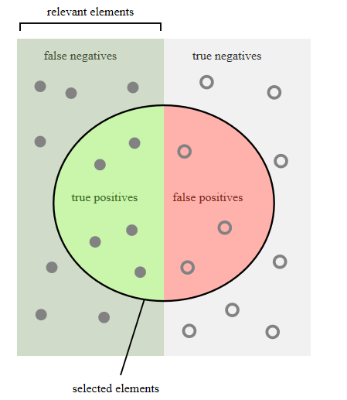
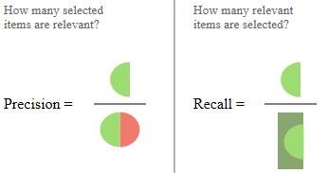
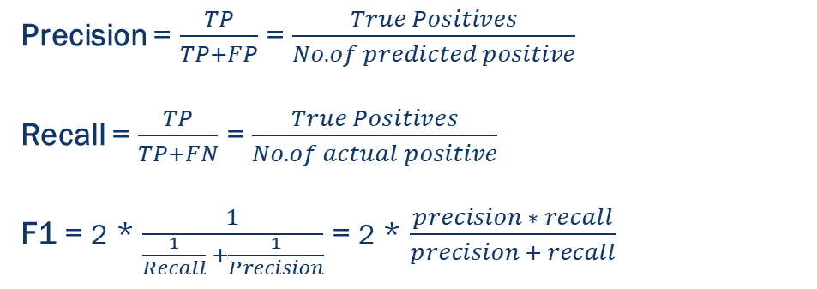
Part 5 – precision, recall, F1
TP
Precision = $\frac{TP}{TP+FP}$ = $\frac{True Positives}{No. of predicted positive}$
Recall = $\frac{TP}{TP+FN}$ = $\frac{True Positives}{No. of actual positive}$
F1 = 2 * $\frac{1}{\frac{1}{Recall} +\frac{1}{Precision}}$ = 2 * $\frac{precision ∗ recall}{precision + recall}$
FP
F1 score is a metric the combines precision (how accurate) and recall (how good at detecting).
It penalizes situations where classes are skewed and the model fails at detecting instances of the minority class.
FN
TN

Slide 35

Part 5 – evaluating the model – precision, recall, F1
TP
Not really.
After plotting the confusion matrix I can see that both my precision (TP/(TP+FP)) and recall (TP/(TP+FN)) are 0.
Hence my F1 score is 0!
More importantly, the model failed to correctly classify any of the positive cases.
True positives
0
TN
False negatives
5
FP
Wow! I’ve built a classifier that is 99.5% accurate!
False positives
0
True negatives
995

Slide 36
Debriefing

Slide 37
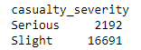
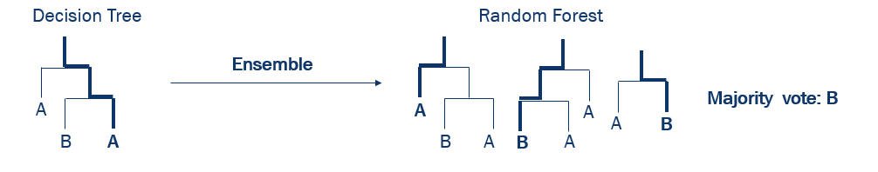
What could we have done differently?
With the data:
Chosen different features
Stratified against our target classes
Tried to collect more data
Used cross validation to improve model parameters
Not ideal
Used a different technique:
Random forest
Another classification algorithm, e.g. support vector machine (SVM), neural networks

Slide 38
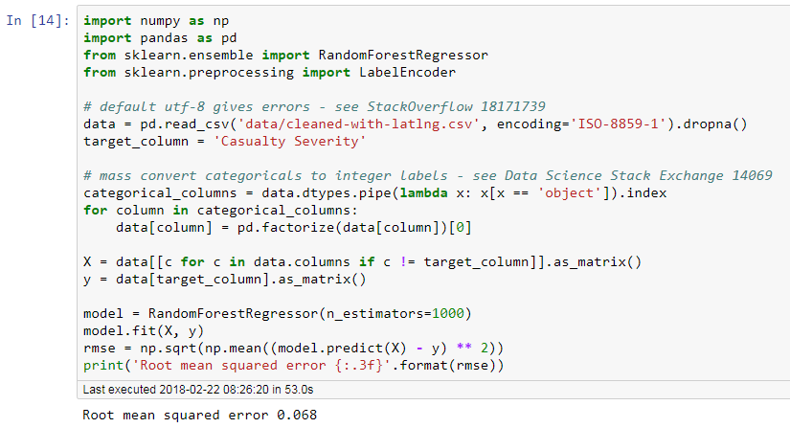
How not to do it…

Slide 39
How not to do it…
Didn’t look into encoding issues
Didn’t explore NaNs, threw away data
Blindly encode ‘problem’ columns to categorical – didn’t read the linked answer, just copied the code
No train/validation/test split
Inappropriate metric for classification task
Used a regressor to solve a classification problem
No thought for model hyperparameters – bigger is better?

Slide 40
Machine learning workflow
Improve the model
INCOMPLETE
Getting the data
Preparing the data for training
Training and evaluating a model
Slow, often very manual, requires consideration, planning, domain knowledge & research, etc.
This is 90% of data science/ML
Quick and mostly handled by packages and frameworks

Slide 41









Resources
@Manc_ML
Local meetups
@herplusdatamcr
@manchester_data
Competitions and projects
www.datakind.org
Free online courses
www.kaggle.com
Help sites
www.edx.org
www.coursera.org
Blogs
www.stats.stackexchange.com
www.quora.com

Slide 42
We’re done!
These slides and the notebooks will be available on the GitHub page you were sent a link to by email.
https://github.com/INRIX-rebecca-davey/python-ml-workshop
Any problems or follow up questions - datascienceevents@inrix.com

